Slide 1
Introduction
to
Postmodernism
Semiotics
(part 2)

Slide 2

Roland Barthes
French (1915 - 1980)
post-structuralism
Notes:
If we're talking about structuralism, and we're describing post-modernism, then it only makes sense that we talk about post-structuralism, right? Post-structuralists were a group of French intellectuals in the 1960's and 1970's who grew out of structuralism, and ended up critiquing many of it's ideas. Roland Barthes is one such post-structuralist, and one who took Sausurre's ideas one step further.

Slide 3
semiotics
SIGN
signifier | signified
Notes:
Now, remember, semiotics says that all meaning is communicated with signs, which are made of both a signifier and a signified.

Slide 4
SIGN
SIGNIFIER sign |  | SIGNIFIED
signifier | signified
MYTH
Language
Notes:
Barthes said myth was a "second level signifier" that takes it's meaning from signs. He use the idea of Myth to describe the beliefs we hold as a society.

Slide 5
THE IDEA OF THE AMERICAN FLAG
“American Flag”
Notes:
Let's look at this in terms of the American flag. Now, when I say "American Flag" that is the signifier, and you picture in your mind the American flag and that's the signified. Together they are the sign that communicates the idea of the American flag.

Slide 6
THE IDEA OF “AMERICA”
THE IDEA OF THE AMERICAN FLAG |  | everything that is America
“American Flag”
Notes:
What Barthes is saying is that the idea of the American flag also acts as a signifier, and what is signified is everything that we believe to be true about America today.

Slide 7
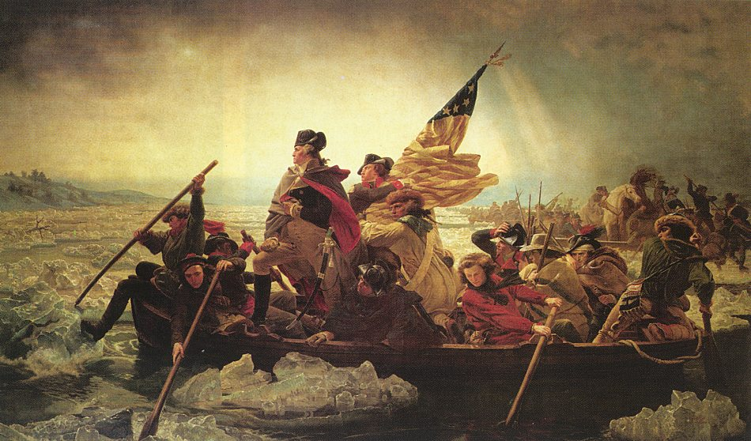
Notes:
One nation, under God, indivisible and all that stuff, is what he refers to as a Myth, an idea that’s larger than life we believe or create or imagine. Sometimes these ideas become so big, that we sometimes take them for granted. What is this a picture of really, George Washington, or the idea of "America"?

Slide 8
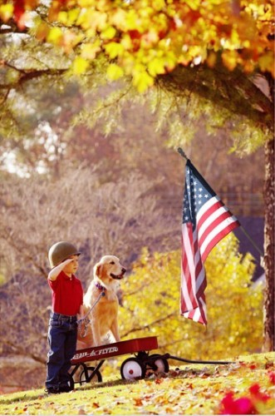
Notes:
For some, the ideas represented by myths are so important, that to even question them is an act of betrayal.

Slide 9
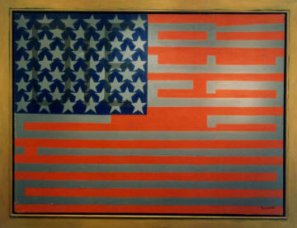
Notes:
And that is why they become such tempting images for artists. Faith Ringgold, in "Flag for the Moon" turns the stripes of the flag into a racial slur. We have three signifier here: The most immediate is what we see first: the American Flag. The second is the obscured racial slur hidden in the flag, which points to the racism and history of slavery that is also part of this nation. Lastly, we have the title. The same year she completed this painting, 1969 was also the year we landed a human on the moon. By putting these three signifiers together, and what they signify, she melds them together into one complete sign, the question that is often asked, "How come we can land a man on the moon, but we cannot end racism and inequality?"

Slide 10
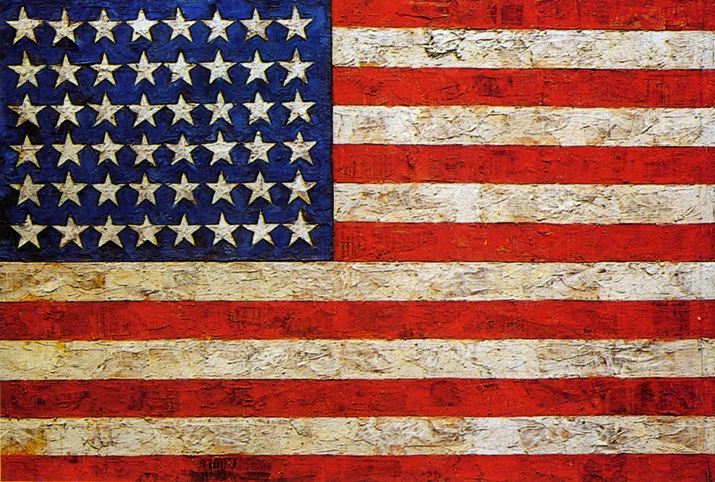
Notes:
Jasper John's appropriating the American flag is a powerful work for a very different reason. He asks us to just look at the flag again as if for the first time. He says he is interested in "What the mind already knows". We know this flag, we see is all the time.

Slide 11
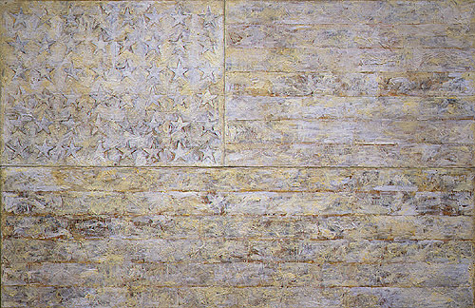
Notes:
In fact he experiments with removing signifiers, in this version all the color, to show us how the American flag is still signified. When he presents us with the flag, and doesn't ask that we take any specific meaning away from the work, this is what we refer to as an open-ended signifier. And it is this openness to seeing, openness to experience that Artists want to create in their viewers.

Slide 12
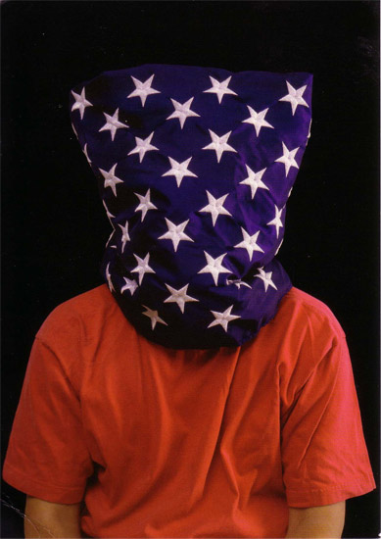
Notes:
It's one thing when criticism comes from within, but when we are criticized from the outside it becomes even harder to evaluate messages in terms of the signifier and the signified, to not return to our firmly held beliefs.

Slide 13
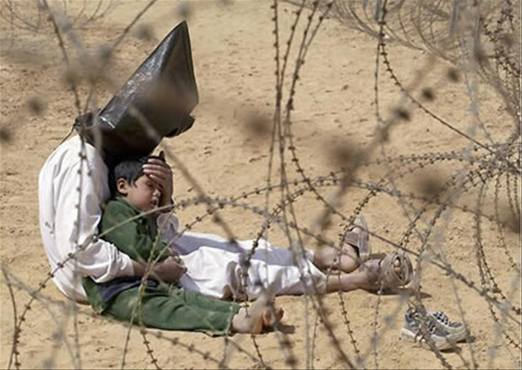
Notes:
Art presents us with powerful messages to force us to reevaluate our opinions, our conclusions, the structures we take for granted or accept complacently.

Slide 14

Notes:
Artworks present these combinations of signifiers to us in an organized way. They allow us a chance to practice reading images for the messages they contain. This in tern helps us to be able to read the images that come from the much more complex and chaotic world at large. If we understand signification at the level of Myth, we can start to understand the world in which we live. Remove our own culture and language, it is images alone that convey what is signified.

Slide 15


Slide 16
Images:
Emanuel Gottlieb Leutze, Washington Crossing the Delaware, 1851
Faith Ringgold, Flag For the Moon (Die Nigger), 1967–69
Jasper Johns, Flag, 1954
Jasper Johns, White Flag, 1955
Hans Haacke, Stargazing, 2005
Jean-Marc Bouju, Iraqi Prisoner, 2003
images Reuters/AP September 11, 2012 Cairo Egypt
Notes:
Emanuel Gottlieb Leutze, Washington Crossing the Delaware, 1851
Faith Ringgold, Flag For the Moon (Die Nigger), 1967–69
Jasper Johns, Flag, 1954
Jasper Johns, White Flag, 1955
Hans Haacke, Stargazing, 2005
Jean-Marc Bouju, Iraqi Prisoner, 2003
images Reuters/AP September 11, 2012 Cairo Egypt

